Slide 1
Testing in TDD spirit
Test is like sex – even if it’s bad, it’s better than nothing!?
Michał Bryłka, Capgemini

Slide 2
Schedule
Day 1
Theory
The Goods
The Bads
The Uglies
Short live trainings
Various interesting tests variants
Day 2
Testing in TDD spirit
Breaks anyone ??

Slide 3
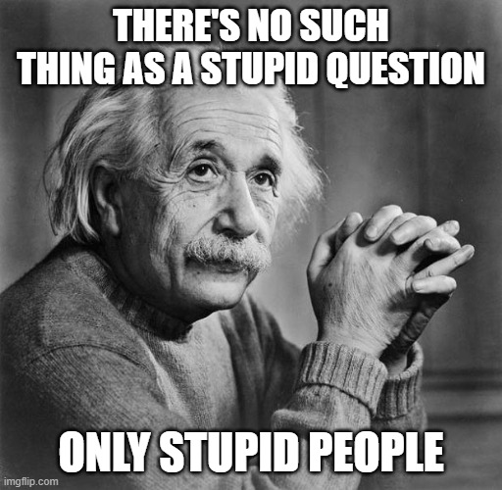
Rules

Slide 4


Who are we ?

Slide 5
Who are you ?
Name
Job title
Experience (i.e. in testing, development, IT)
Expectations

Slide 6
Agenda
Unit vs other tests
Why?
How?
Some do it better
Obstacles

Slide 7
Rules
„That all depends”
C# / .NET / Visual Studio == everything else
Key words for use in RFCs to Indicate Requirement Levels
https://tools.ietf.org/html/rfc2119
My „must” – in my team
In order to let it go, you need to possess it

Slide 8
Glossary
OUT/SUT – Object/Subject Under Test - class we are testing
Test Doubles
Mock – object with expectations
Stub - object behaving in given way
…
https://www.martinfowler.com/bliki/TestDouble.html
Lambda Expression e.g. (x,y) => x + y
Interface / contract
Dependency Injection

Slide 9
Reasons
Code works as expected ⭢ self-confidence
Regression bugs detection
Code tested ⭢ (quite often) code well designed ⭢ SOLID
Run code regardless large systems around
Mouse clicks reduction
Less debugging == happier team
Introducing new team member
Custom testing system == perfect starting point for system hand-over

Slide 10
Reasons
Legacy systems – façade + facilitating injections
Usage documentation, use case specification
No code comments anymore !!!
TDD ⭢ YAGNI
OSS – failing tests (bug manifestation)
Time capsule
Temporal proofing
Upgrade path detector
Performance guard

Slide 11
Test kinds
Logical tests
Unit test
Micro-test
Acceptance („business”) test
Funtional test (wider, mocked context)
Mutation testing
Convention tests
Configuration (end-to-end) tests
Integration test
System test

Slide 12
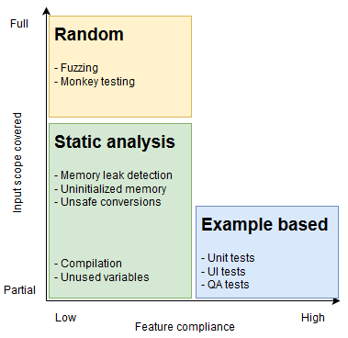
Testing techniques
?

Slide 13
Exercise –how would you test…
double.Parse()
Database connection
Database stored procedure logic
Code dependent on slow network connection
Event based system
Transaction system
Time dependencies
Exchange trading system

Slide 14
Frameworks – (unit) tests
(x)Unit frameworks, presented on XP2000 conference (.net 1.0 - 2002!)
nUnit
xUnit
jUnit
…
MS Tests
https://en.wikipedia.org/wiki/List_of_unit_testing_frameworks#.NET_programming_languages

Slide 15
NUnit
Attributes
manage lifecycle of test (setup, tests, tear down)
providing data to the test (e.g. values, range, generators, combinatorics)
helpers (e.g. SetCulture, Category)
Assertions
Classic
Assert.AreEqual( expected, actual )
Constraint-based
Assert.That(actual, Is.EqualTo(expected) )
Warning: what is expected, what is actual - change in order will lead to misleading error messages!!!
Test Context
Names of the test, properties. Rarely used

Slide 16
NUnit
Execution order
[TestFixture] - class
[OneTimeSetUp] / [SetUp]
[OneTimeTearDown] / [TearDown]
[Test] / [TestCase] / [TestCaseSource]

Slide 17
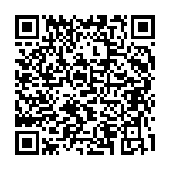
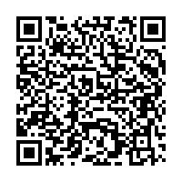
Demo
AttributesLifecycleExample
https://github.com/nemesissoft/Nemesis.TextParsers/blob/master/Nemesis.TextParsers.Tests/ExploratoryTests.cs
AttributesLifecycleExample
DataAttributesExample
https://github.com/nemesissoft/Nemesis.TextParsers/blob/master/Nemesis.TextParsers.Tests/Deconstructable/DeconstructableTests.cs
DataAttributesExample

Slide 18
Naming
Bad naming
[Test] public void Hero8() { Assert.That(1+3==4);
Assert.That(3+1==4);
}
Good naming
[Test] public void AdditionShouldBeCommutative() { Assert.That(_calc.Add(1, 3), Is.EqualTo(4));
Assert.That(_calc.Add(3, 1), Is.EqualTo(4));
}

Slide 19
Naming variants
AddShouldReturnProperResult
WhenAdd_ShouldReturnResultOfAddition
When_Add__Should_Return_Result_Of_Addition
Multiply_WhenTwoPositiveNumbersAreMultiplied_ShouldReturnPositiveResult
Tests are not part of API, nor will they ever be invoked directly
Rewriting names ?
Potential runner issues

Slide 20
Naming - rewriting names
private static IEnumerable<TestCaseData> GenericInterfaceTests() { var data = new (Type type, Type generic, bool expectedResult)[] { (typeof(List<string>), typeof(IEnumerable<>), true), (typeof(int), typeof(IEquatable<int>), true), };
return (from d in data select new TestCaseData(d.type, d.generic).Returns(d.expectedResult) .SetName($"{d.type.GetFriendlyName()} {(d.expectedResult ? "->" : "!- ")} {d.generic.GetFriendlyName()})") ).ToList();
}
[TestCaseSource(nameof(GenericInterfaceTests))] public bool ImplementsGenericInterface(Type type, Type generic) => type.DerivesOrImplementsGeneric(generic);

Slide 21
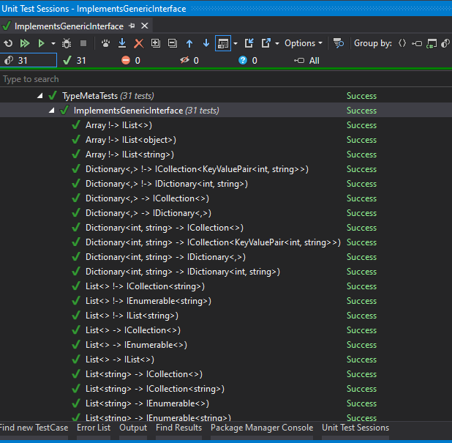
Naming - rewriting names

Slide 22
Expetions handling
Bad naming
[Test] public void TestException() { try { transformer.Parse("Blah"); Assert.Fail(); } catch (Exception ex) { Assert.IsNotNull(ex); } }
Good naming
[Test] public void Parser_ShouldThrowUponMalformedInput() { var ex = Assert .Throws<ArgumentException>(() => transformer.Parse("Blah")); Assert.That(ex.Message, Does.Contain(expectedMessagePart));
}

Slide 23
Running
Console and GUI runner
Visual Studio / RAD integration
Resharper – industry choice
Ctrl+U,Ctrl+R - runs current „context”
Ctrl+U,Ctrl+D – debug
Ctrl+U,Ctrl+U – repeat last run

Slide 24
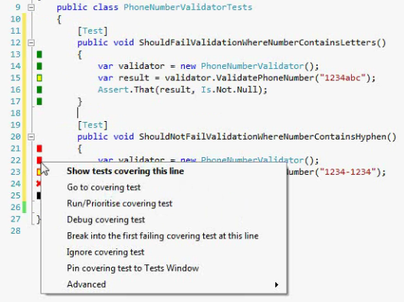
Running
In background
NCrunch (proprietary license, 160 USD)
Live Unit Test (VS Enterprise)
ContinuousTests (not under active development)
…

Slide 25
Test doubles – managing dependencies
Create mock
_dep = new Mock<IMyDependency>()
_dep = new Mock<IMyDependency>( MockBehavior.Strict )
IMyDependency actualObject = _dep.Object;
Program mock so it will behave correctly. Fluently if possible.
_dep.Setup( x => x.MyMethod( "bar" ) ).Returns( 123 )
_dep.Setup( x => x.MyMethod( "foo" ) ).Throws( new Exception( "abc123" ) )
Or alternatively just check if mock was (not) called
_dep.Verify( x => x.MyMethod( "bar" ), Times.Exactly( 5 ) )
_dep.Verify( x => x.MyMethod( "blah-blah" ), Times.Never )

Slide 26
Demo - mocks
FileProcessor
PigFoodPriceProviderTest

Slide 27
Moq is not your only choice !!!
FakeItEasy
Nsubstitute
Telerik JustMock Lite
Typemock - isolator
RhinoMocks – old but mellow

Slide 28
FIRST
Fast
Isolated
Repeatable
Self-verifying
Timely

Slide 29
Fast
Don't call external systems (DB, web services, files) – double them
Reduce amount of data to process to a small, representative sample
Distinguish between integration/long running and fast unit tests - run the latter ones frequently
Unit tests execution should be „instant”

Slide 30
Isolated
One reason to fail ⭢ „one” assert per test
Potential problems in external systems are eliminated
Tests don't affect each other
Beware static classes/methods, singletons, databases!
Order of test execution must not matter!
Arrange-Act-Assert*

Slide 31
Repeatable
Static data, in-memory structures not cleaned up
External systems keeping state
Non-deterministic behaviour: threads/processes/order of test executions
Other classes which failed to initialize properly due to time
Dependable / deterministic
new Random(42)
Seeded (persisted) random values

Slide 32
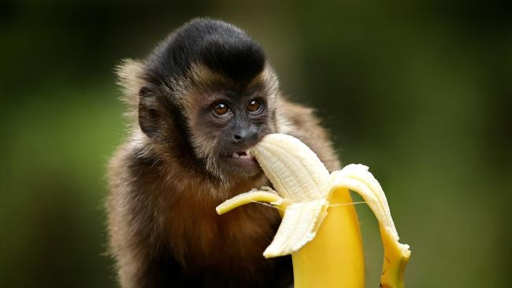
Self-Verifying
No "partial success"
No field for interpretation
user cannot be forced to read console output
Possible exception: images, patterns, science
Green (pass) == GOOD, Red (fail) == BAD
Test without assertions will often pass in most cases ;-)

Slide 33

Timely
Don't wait ages to write the test
Test-Driven Development
Test-After Development

Slide 34
AAA
Arrange
Creates "context" for the test
Use testing doubles as much as possible here
Act
One single operation we want to run using "context" prepared in Arrange part
Capture various results/side effects of operation
Assert
Test all results, with appropriate granularity
Check all side effects (expected, not allowed)

Slide 35
AAA
[Test]
public void WhenAdd_ShouldReturnResultOfAddition()
{
//arrange
var x = 10;
var y = 0.5;
var calculator = new Calculator();
//act
var result = calculator.Add( x, y );
//assert
Assert.That( result, Is.EqualTo( 10.5 ) );
}

Slide 36
AAA
[TestFixture]
public class Calculator_WhenAdd_ShouldBeCommutative { double _result1; double _result2;
[OneTimeSetUp] public void ArrangeAndAct() { //arrange var x = 10; var y = 20.0; var objectUnderTest = new Calculator();
//act _result1 = objectUnderTest.Add(x, y); _result2 = objectUnderTest.Add((int)y, x); }
[Test] public void ShouldProduceCorrectResults() { Assert.That(_result1, Is.EqualTo(30.0)); Assert.That(_result2, Is.EqualTo(30.0)); }
[Test]
public void ShouldBothResultsBeEqual() =>
Assert.That( _result1, Is.EqualTo( _result2 ) );
}

Slide 37
Assertion styles
Assert.That(TestedMethod() == 15);
Assert.AreEqual(TestedMethod(), 15)
Watch of for parameter ordering !!!
Assert.That(TestedMethod() == 15, "Method should return 15");
Assert.That(TestedMethod(), Is.EqualTo(15), "self explanatory message");
//NLP styled - Fluent Assertions: TestedMethod().Should().Be(15);

Slide 38
Assertion styles
Is.
Empty
Null
…
Iz == Is
Has.
Some.Positive
All.EqualTo(...)
…
Does.
Exist
Contain
…
Throws.
…

Slide 39
Legacy systems
Static Methods
„Static” IoC
Initialization
Cleanup
Facade / Seam
Composition/substitution

Slide 40
Best practices
CI/CD
MySystem.Tests.dll – pattern recognized by CI/CD
[InternalsVisibleTo("*.Tests")]
[InternalsVisibleTo("DynamicProxyGenAssembly2")]
Subfolders in main solution
...and for name of test use pattern ClassName_WhenSomeMethodCalled

Slide 41
Obstacles
Hard to start writing tests - ask people who already do it!
Find the right balance (e.g. do you need to test auto-properties or every single implementation detail?)
False sense of security
Management
Code coverage - reduces the tests to a single number. Is it going to affect your bonus?
Bloody time wasters - these unit test writing developers
Maintenance costs
No team review => tests are understood by creators only

Slide 42
„Secret tests”
Public vs private members
System is entitled to it’s „secrets” / implementation details !?
using Moq.Protected; var mock = new Mock<MyClass>(); mock.Protected() .Setup<int>("MyProtectedGetIntMethod") .Returns(1);

Slide 43
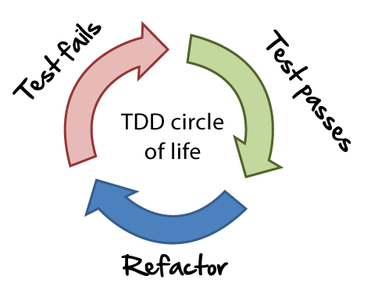
TDD workflow
red-green-refactor
Make it work. Make it right. Make it fast.
red-commit-commit-commit-green-refactor-squash-push* (Git/Mercurial only)
TDD != test-first
TF ⊂ TDD
Refactoring == daily activities, not task „kind”

Slide 44
TDD vs BDD
TDD ≈ BDD - ⅓ of a difference ? ;-)
BDD != TDD
TDD for unit, BDD for integration
BDD == TDD done right

Slide 45
BDD == Given-When-Then ?
public void ValidOrderShouldBeFilled_WhenMarketIsFavourable() {
var orderId = Given .NewOrderIsSent(symbol: "VOD.L", quantity: 100);
When.MarketIsFavourableFor("VOD.L");
Then.OrderIsFilled(orderId); }
//Arrange
//Act
//Assert

Slide 46
BDD – Benefits
Shift Left – faster feedback
Stronger collaboration
Contract between analysts and tech
Ubiquitous language
Business
Tech

Slide 47
Conventions tests
Check team standards
FxCop
StyleCop
Own solutions
Check architecture constrains, not possible to assert upon otherwise
Reflection
Roslyn

Slide 48
Conventions tests
Every IConfigItem descendant must end with „Config”
class ExchangeCalculatorConfig : IConfigItem {
public int MultiplicationFactor { get; internal set; }
public string AllowedStatus { get; set; }
public ExchangeCalculatorConfig(int multiplicationFactor, int allowedStatus) { MultiplicationFactor = multiplicationFactor; AllowedStatus = allowedStatus.ToString(); }
}
Used only in tests
Conversion not allowed

Slide 49
Extending testing framework - demo
ConsoleActionAttribute
ConsoleIO
ExpectedExceptionTests

Slide 50
Summary
BEFRIEND AND „LOVE” YOUR TESTING FRAMEWORK
Test document
what you want your code to do
how your team want to use it
Composition over inheritance - IoC
Code & test reviews
tests code == code
tests of tests !?
Prepare your own team tools & standards
FIRST, AAA
CI / CD / CD
„Live” unit tests
Data oriented tests

Slide 51
TDD Kata
https://github.com/garora/TDD-Katas/tree/master/src
https://github.com/ScioMx/TDD-Training

Slide 52
Q&A
Thank you for attention

